Slide 1
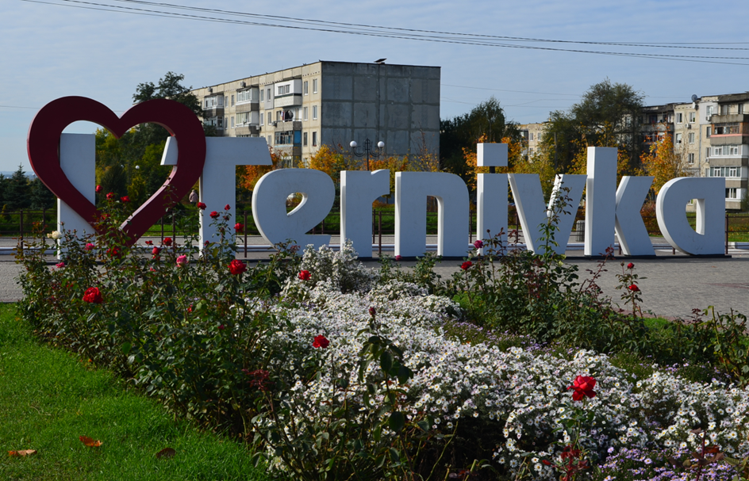
INVESTMENT PASSPORT of Ternivka urban TERRITORIAL COMMUNITY

Slide 2

TABLE OF CONTENS
  1. Historical reference
  2. General information
  3. Physico-geographical position
  4. Education, health care, culture and leisure, sports
  5. Labor resources
  6. Economic potential
  7. Community budget
  8. Investment development of the territory
  9. Factors of investment attractiveness
  10. Land plots attractive for investment
  11. The objects are attractive for investment
  12 Contacts

Slide 3
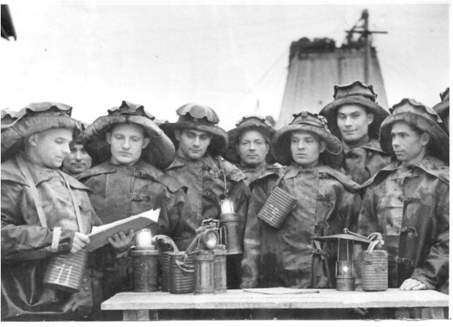
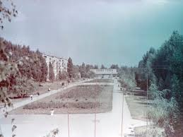
HISTORICAL REFERENCE
TERNIVKA is a mining town, located in the center of Western Donbass
The first written mention of Ternivka dates back to July 13, 1774. The settlement was founded as a transit point on the road from Balaevskaya Tower to Bakhmut and developed as a rural settlement.
The transformation of Ternivka into a city is connected with the beginning of industrial mining of coal deposits.
In 1952, the construction of the first exploratory and operational mine near the village of Ternivka began, and the first coal was mined in June 1959. In 1976, Ternivka received the status of a city.

Slide 4
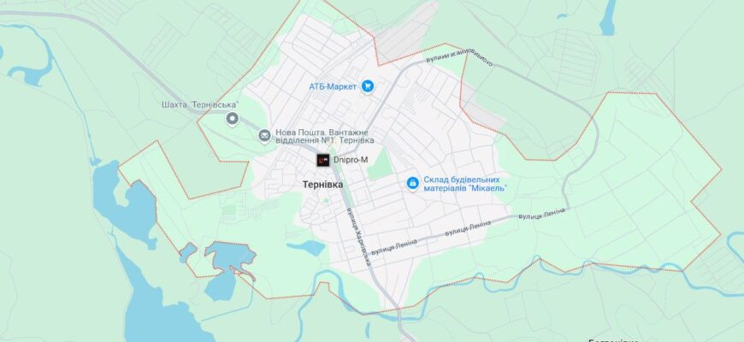


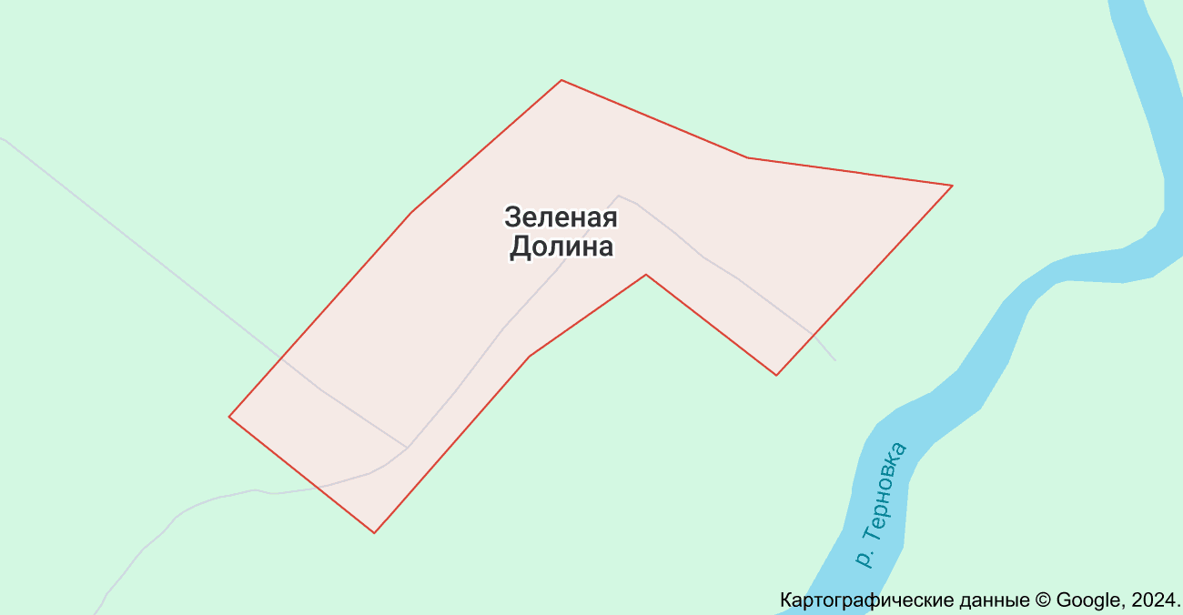


GENERAL INFORMATION
The city of Ternivka - the administrative center of Ternivka urban territorial community, Pavlograd district, Dnipropetrovsk region
Quantity of settlements – 2:
The town Ternivka
The village of Zelena Dolyna
Population:
23,8 thousands
Сommunity area:
17,31 km²

Slide 5


Physico-geographical position
TERNIVKA is a small city of regional subordination, which is located near the Velika Ternivka River at its confluence with the Samara River. The city of Ternivka is located on the territory of Western Donbas in the east of the Dnipropetrovsk region, 20 km east of the city of Pavlograd.
The southern part of the city territory is crossed from east to west by the Ternivka River, a tributary of the Samara River.
The relief of the city is a slightly hilly steppe plain with a slight slope from north to south to the floodplain of the Velika Ternivka River. The rivers in this place are winding, forming estuaries, old lakes and marshy lakes. Surface marks range from 65 to 145 m.
The territory of the city is included in the Dnipropetrovsk central soil district. The soil-forming rocks are loamy loams, which have a light clay mechanical composition. The soil cover is represented by medium humus chernozems, mainly saline soils, which are distinguished by a significant depth of humus penetration (up to 85-95 cm).
Public green spaces are represented by city-wide parks, squares, and avenues.
The climate in the area of ​​the city is moderate-continental, characterized by high summer air temperature, lack of atmospheric precipitation, rare heavy rains and significant dry winds of mainly eastern and southeastern direction, reaching 20-25 meters per second, which cause drought in summer, sharp in winter decrease in temperature.
The coldest months of the year are January and February. Sometimes the air temperature drops to -25.9 °C. The warmest month is July, the average daily temperature of which is +21.5 °C. The transition of the temperature through 0 °C in spring occurs in the second decade of March, and in autumn - in the third decade of November. The depth of soil freezing in this area is up to 1.0 m
The amount of precipitation is 450 mm per year, which indicates insufficient moistening of the territory, the least of which falls in the winter period. From March, the amount of precipitation begins to increase, reaching a maximum in June-July.
The main natural wealth of the city of Ternivka is a coal deposit.

Slide 6
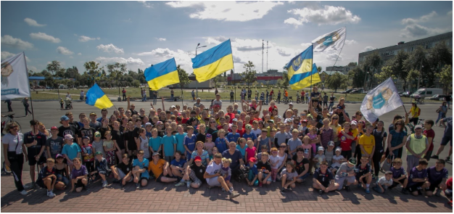
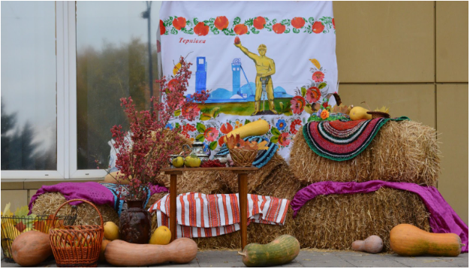
Education, medicine, culture and leisure, sports
EDUCATION. There are 5 institutions of general secondary education, 5 institutions of preschool education, 1 out-of-school education institution, 1 vocational and technical institution in the city of Ternivka.
MEDICINE. Ternivka's health care sector includes the Ternivka Primary Health Care Center (3 outpatient clinics), the Ternivka Central City Hospital of the Ternivka City Council, 9 private medical offices and laboratories.
CULTURE. There are three municipal public libraries in the city, the Terniv city council art school with music and art departments, the Terniv city center of culture and leisure ("Shakhtar" shopping center and the S. Markov cultural center), the Ternivka city museum of local history.
SPORTS. There is a municipal children's and youth sports school in the city, which has six departments for the following sports: basketball, boxing, volleyball, handball, table tennis and athletics, where 372 students study. On the territory of the city of Ternivka, 17 physical culture and health clubs for various sports are registered. Currently, the city has 7 street sports grounds..In the municipal Park of Culture and Recreation there is a sports sector that combines a sports ground with training equipment for fitness, powerlifting, bodybuilding, a sports ground for parkour, a sports ground for street workouts and a sports ground for skateboarding "Skate Park". There are also simulators for physical education for persons with disabilities.

Slide 7
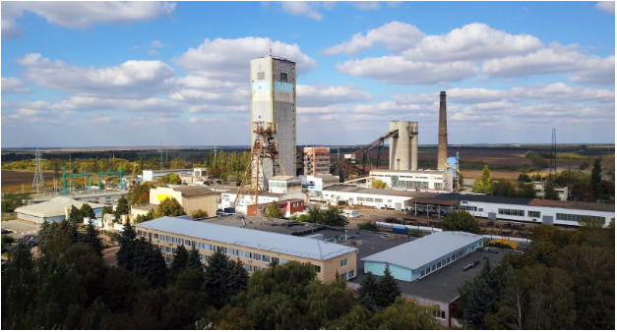
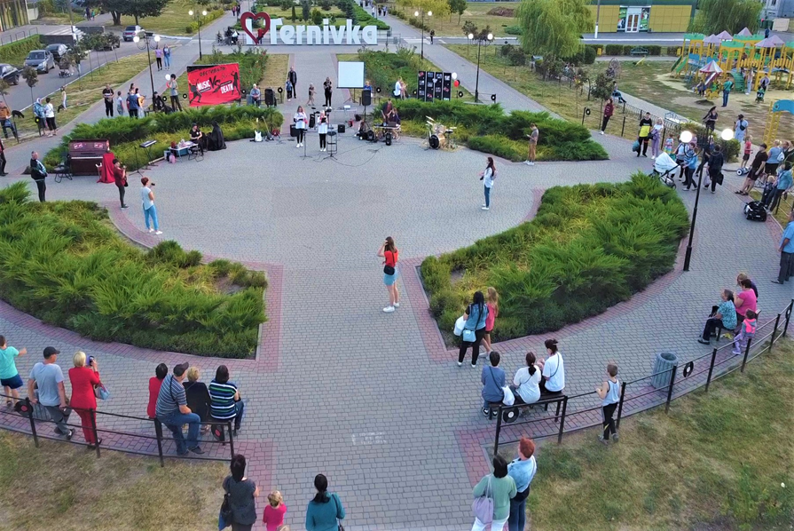
LABOR RESOURCES
23,814 people and 6,045 internally displaced persons live on the territory of the community.
The population aged 15 to 70 is 17,533.
Quantity of registered enterprises is 281, individual entrepreneurs are 869.
Quantity of working people: at enterprises 4976; 903 from individual entrepreneurs.
Quantity of employees in the industry: Ternivske Mine Management "DTEK PAVLOGRADVUHILLYA" - 3,530 people
The community has 3 farms
Quantity of trade objects: food – 108, industrial – 91
Quantity catering establishments is 24
Quantity establishments that provide household services is 93.

Slide 8
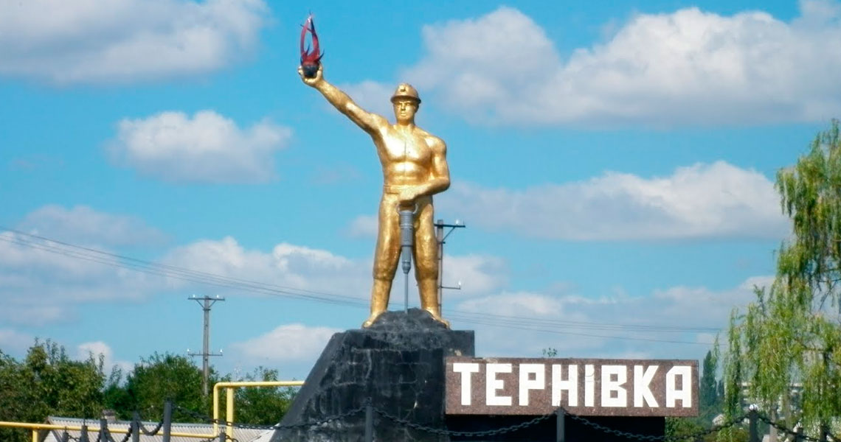
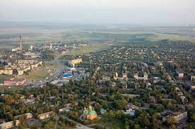
Economic potential
The industrial infrastructure of the city is monofunctional and represented by two mines "Ternivska" and "Zakhidno-Donbaska" of "DTEK Pavlogradvugillia".
The municipal enterprise "Ternivske Housing and Communal Enterprise" operates in the city, which provides a full range of communal services to residents.
The nearest nodal railway station is the city of Pavlograd, located 23 km west of Ternivka.
The distance to the regional center is 100 km and passes along the E50 highway, which coincides with the M04. Connections with populated areas of the region and Ukraine are provided by a network of local highways.

Slide 9


COMMUNITY BUDGET
The implementation of own revenues of the general fund of the community budget for 2023 amounted to 231,344.5 thousand UAH.
Income from personal income tax amounted to 193,033.2 thousand UAH.
Excise tax revenue from excise goods (products) fuel produced in Ukraine amounted to 259.6 thousand UAH.
8,927,000 UAH were received from the excise tax on the sale of excisable goods (alcohol products, beer, tobacco products) by business entities in the retail trade
Revenues from local taxes and fees amount to 26,493.0 thousand UAH.
In the total amount of community budget expenditures, the most specific weight is the expenditure on the social sphere of the city - education, medicine, social protection of the population, sports, youth policy (57.2%) and on the functioning of municipal housing and communal services of the city (25.3 %)

Slide 10
Investment development of the territory
The Ternivka community is implementing the Strategic Plan for Economic Development:
https://ternivka-rada.dp.gov.ua/rishennya-gromadi/pro-vnesennya-zmin-do-rishennya-ternivskoyi-miskoyi-radi-vid-26022016r-86-6vii-pro-zatverdzhennya-aktualizovanogo-strategichnogo-planu-ekonomichnogo-rozvitku-m-ternivka-do-2020-roku-3
Strategic directions and goals of the city's development:
Strategic directions and goals development of the community: development of entrepreneurship, namely: development of entrepreneurship infrastructure, improvement of business conditions provided for by the municipal program for the development of small and medium-sized businesses (https://ternivka-rada.dp.gov.ua/rishennya-gromadi/pro-zatverdzhennia-prohramy-rozvytku-maloho-ta-serednoho-pidpryiemnytstva-mista-ternivka-na-2024-2025-roky-2);
Creation of conditions for attracting investments, namely: development of the resource potential of the city, support and accompaniment of the investor in the territory of the city;
Creation of conditions for a comfortable and healthy lifestyle, namely: development of sports, recreation and entertainment infrastructure, development of communal services, improvement of medical care for city residents, improvement of the state of the natural environment of the community;
The task of the administration of the territorial community is to create an environment on the territory of the municipality that would stimulate the involvement of the widest possible strata of the population in this process, the establishment of partnership relations between the government and business, public associations and citizens, as well as the achievement of sustainable development of the community thanks to the introduction of modern technologies in all spheres of life.

Slide 11












Factors of investment attractiveness
There are 3 banking institutions
There are three operators of postal services
Available high-quality coverage of all major mobile operators
And stable access to the Internet

Slide 12
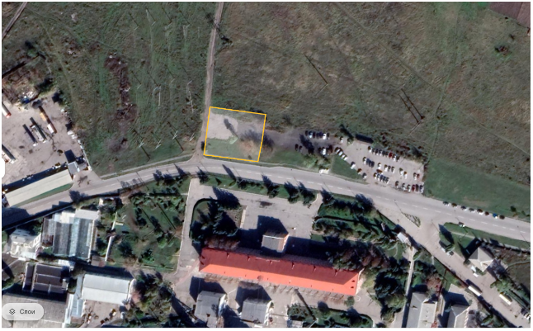
Land plots attractive for investment
A plot of land on the street Kharkivska, Ternivka (near the Ternivska mine)
Land plot with an area of ​​0.1752 ha
This plot of land can be used for the operation of the following objects: fleets of road sweepers, bases for the operation and repair of housing, buildings and structures of engineering equipment that do not have environmental restrictions, garages, parking lots and transport facilities, objects for the sale of construction products, as well as for enterprises household service.

Slide 13
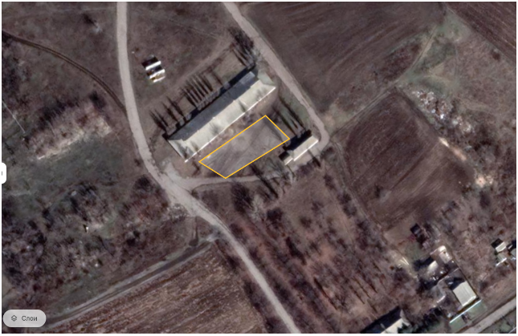
Land plots attractive for investment
ADDRESS: st. Trinity, 60-а, city of Ternivka
The area of the land plot: 0,1136 ha
Cadastral number: 1213500000:01:043:0053
APPOINTMENT: placement of utility facilities - fleets of road sweepers, housing operation and repair bases, buildings and structures of engineering equipment that do not have environmental restrictions, garages, parking lots and transport facilities, special stores for the sale of construction products, household service enterprises.

Slide 14
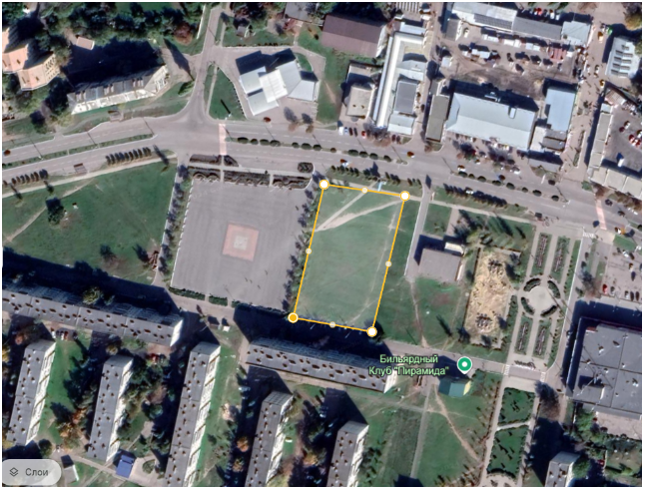
Land plots attractive for investment
ADDRESS: st. Kharkivska, city of Ternivka
AREA: 0,1136 ha
APPOINTMENT: residential building; educational institutions; health care and social security institutions; sports and physical culture and health facilities; parks, squares, boulevards; cultural and art institutions; cult buildings; public catering enterprises; household service enterprises; shops; administrative buildings, offices, management organizations; project organizations, credit and financial institutions and communication companies; hotels; stores without profile restrictions; shopping centers, exhibitions of goods; enterprises of public catering and household services of city-wide importance.

Slide 15
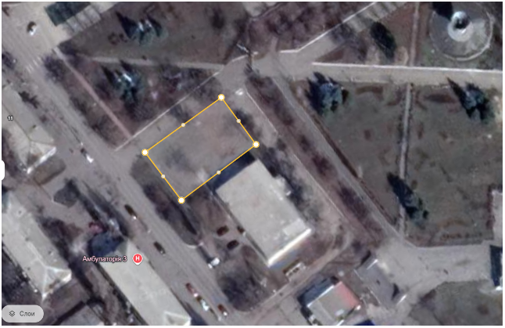
Land plots attractive for investment
ADDRESS : street Igor Petrov, city of Ternivka (District of the Park of Culture and Recreation)
AREA : 0,0545 ha
APPOINTMENT: residential building; educational institutions; health care and social security institutions; sports and physical culture and health facilities; parks, squares, boulevards; cultural and art institutions; cult buildings; public catering enterprises; household service enterprises; shops; administrative buildings, offices, management organizations; project organizations, credit and financial institutions and communication companies; hotels; stores without profile restrictions; shopping centers, exhibitions of goods; enterprises of public catering and household services of city-wide importance.

Slide 16
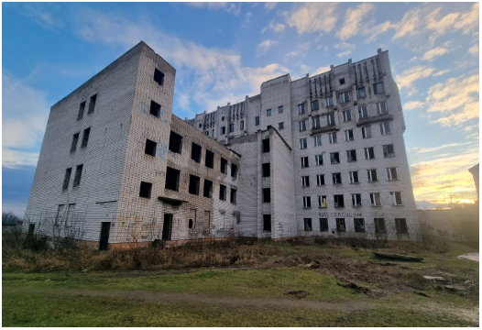
Investment attractive objects
Object of unfinished construction: polyclinic at the address - city of Ternivka, street Sergey Markov, 22а
Total area of ​​the building – 8026,2 m².
The height of the floors – 3,3 m.
The height of the technical floor – 2,2 m.
The construction project includes 2 blocks: a 7-story block of medical and diagnostic offices and a 3-story block of premises for a medical swimming pool and mud therapy. The blocks of the building are connected to each other by a one-story transition.
The project envisages a complex of medical services.

Slide 17
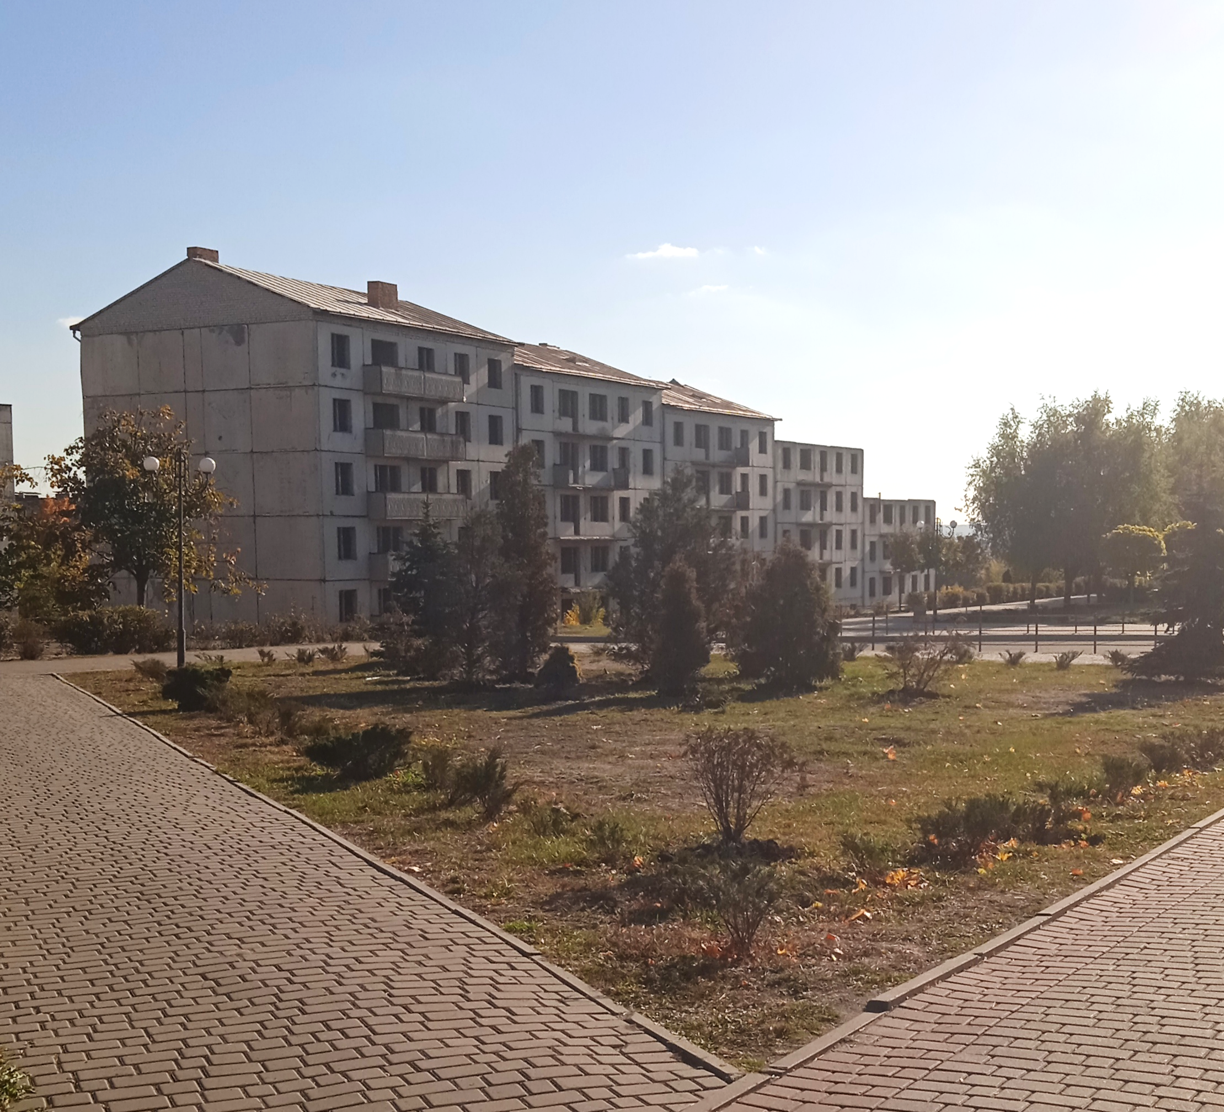
Investment attractive objects
Object of unfinished construction: 5-story multi-apartment residential building at the address: Boulevard Heroes of the Cosmos, 7-V, city of Ternivka, Dnipropetrovsk region;
Total area of ​​the buildings – 2378 m²;
The commissioning of the 45-apartment residential building will provide housing and create appropriate sanitary and living conditions for the comfortable living of internally displaced persons, orphans, children deprived of parental care, participants in hostilities and families of military personnel, single mothers and other residents staying in the apartment building accounting.

Slide 18
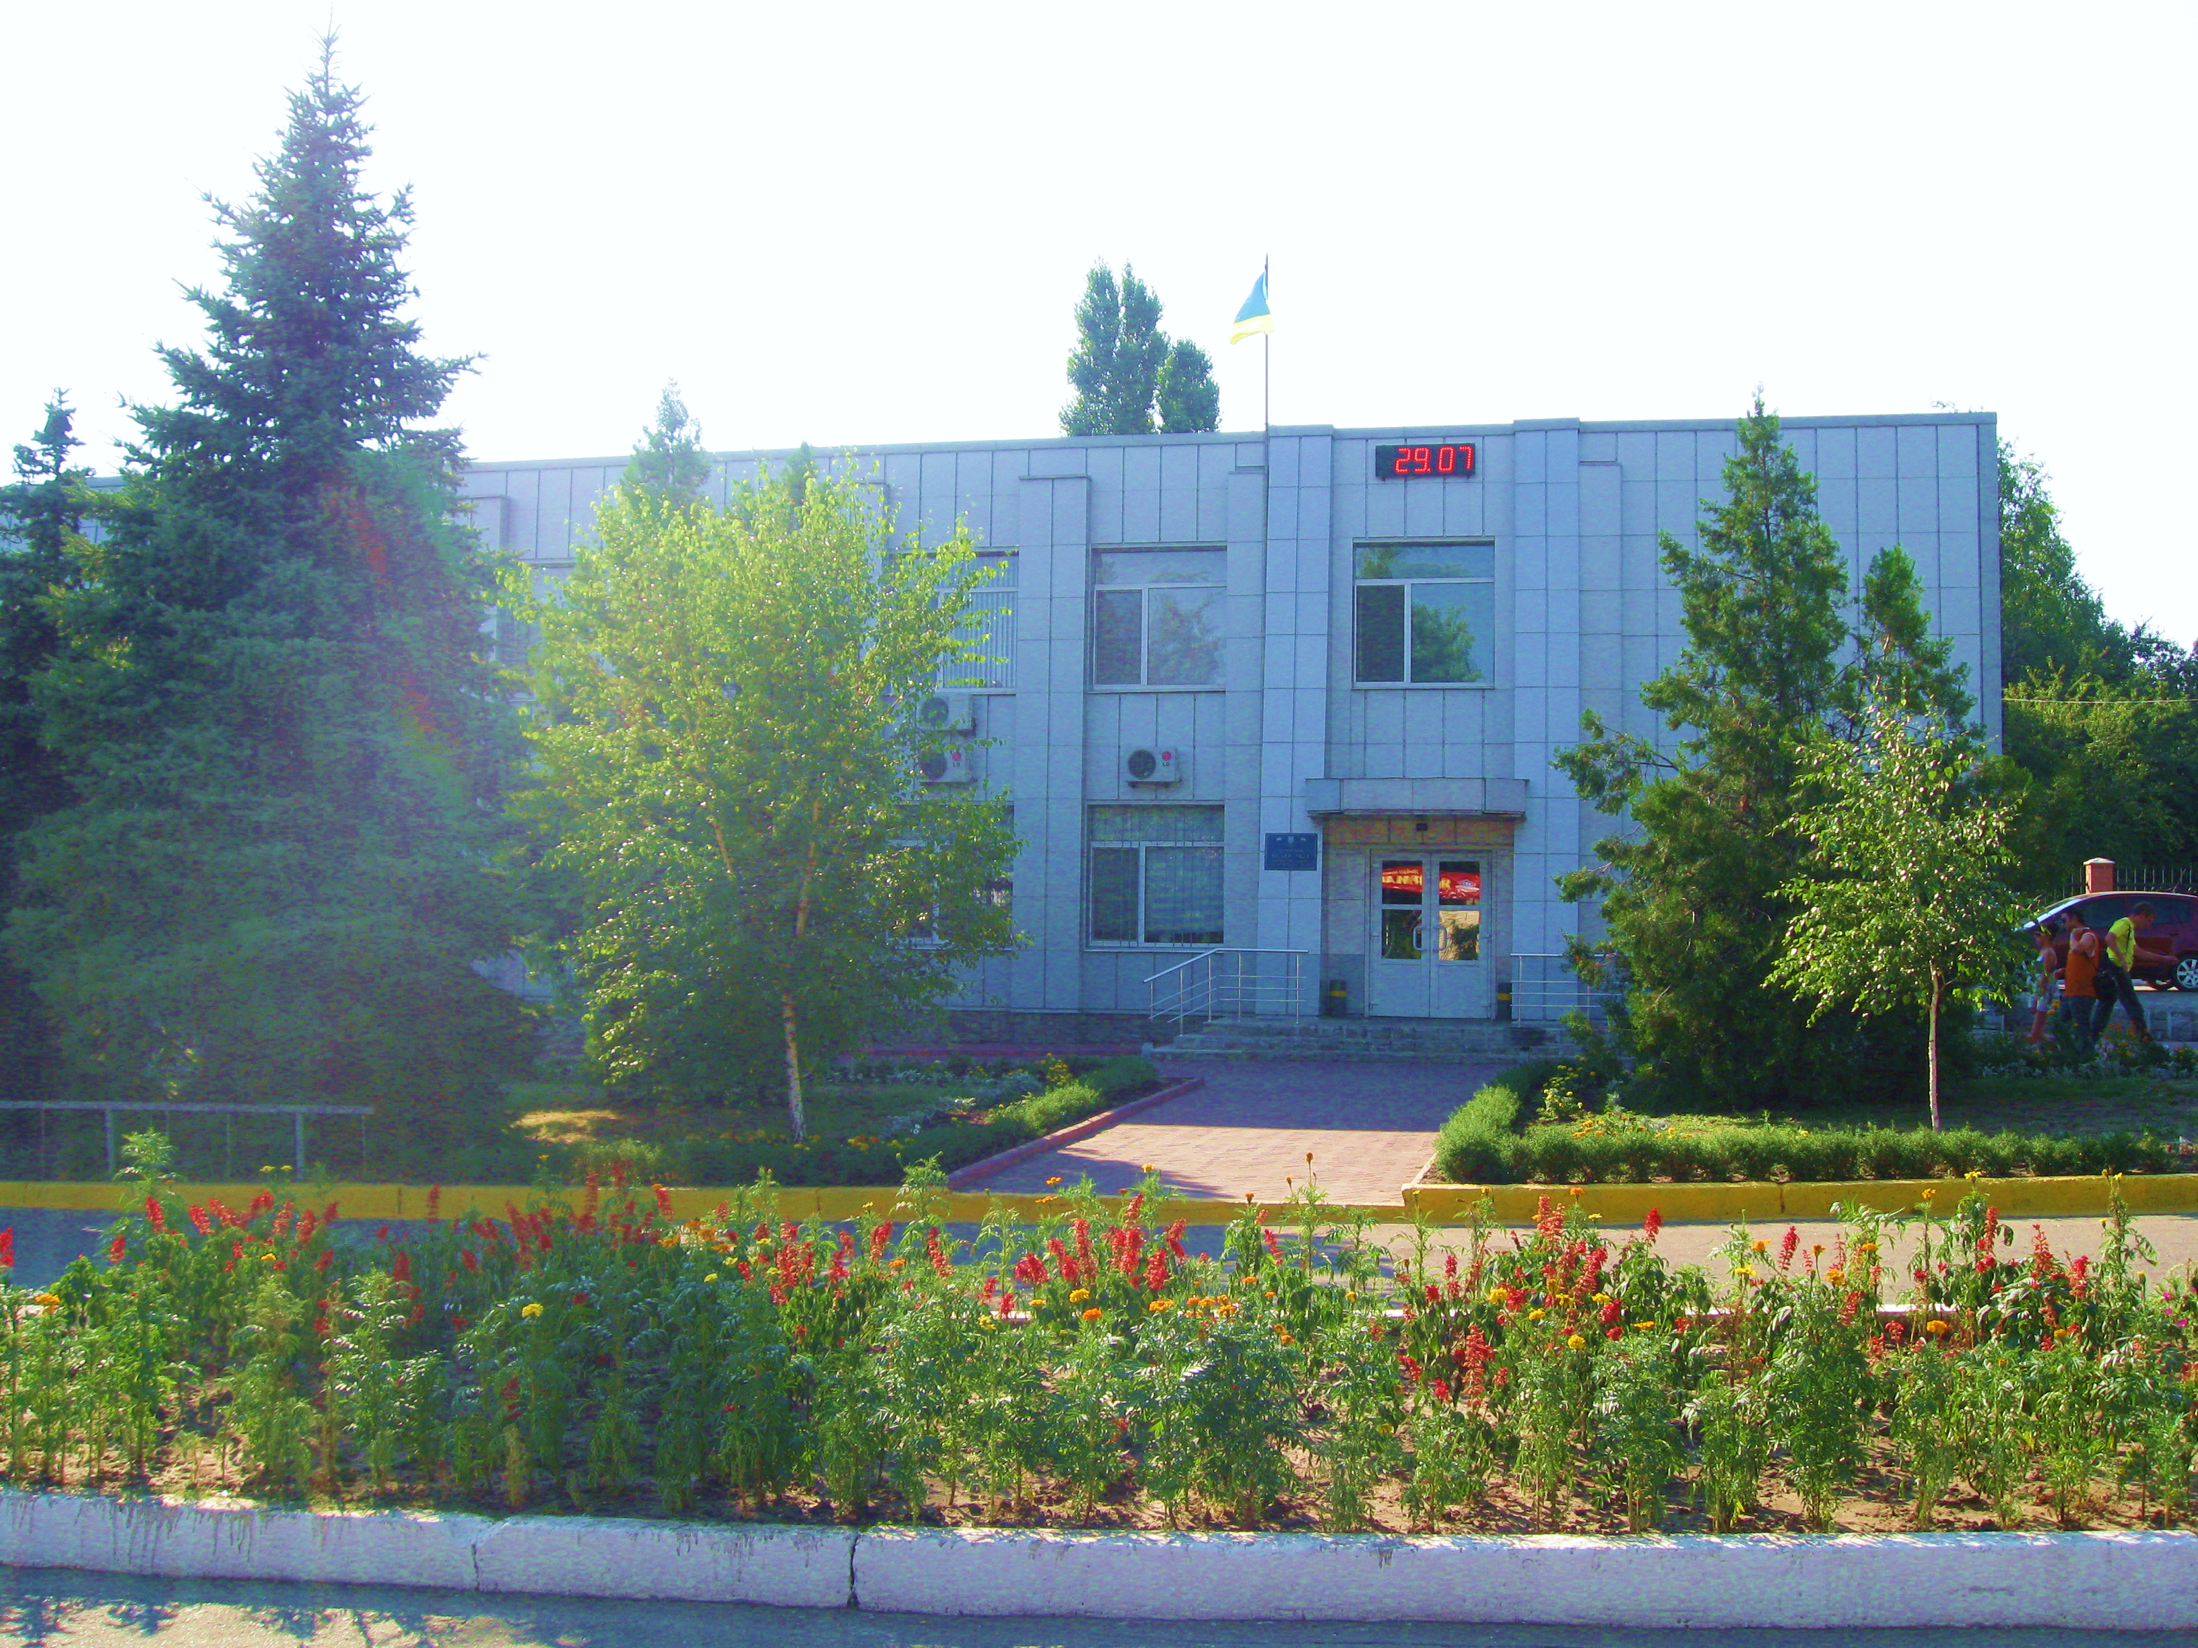




CONTACTS
51500, Dnipropetrovsk region, Pavlograd district, city of Ternivka, st. Mykhailo Hrushevskyi, 5А
+380563269519
+380563269518
info@tern-mrada.dp.ua
https://ternivka-rada.dp.gov.ua
f
https://www.facebook.com/profile.php?id=100064532291970

